Slide 1
Chapter 5 Transport Layer

Slide 2
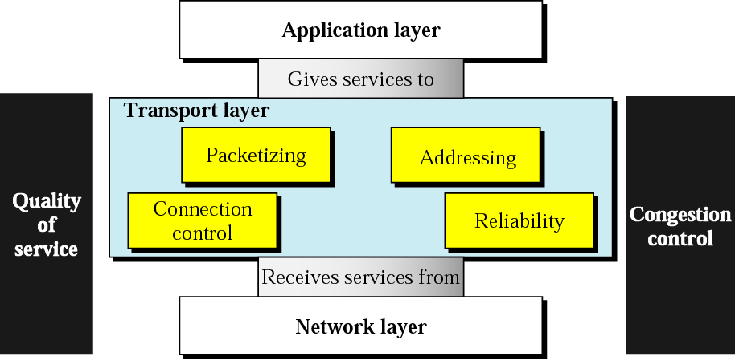
Introduction
The transport layer is a 4th layer from the top of the ISO-OSI Model.
The main role of the transport layer is to provide the communication services directly to the application processes running on different hosts.

Slide 3
Transport Layer Services
End-to-end delivery
Addressing
Reliable delivery
Error control
Sequence control
Loss control
Duplication control
Flow control
Multiplexing
Upward multiplexing
Downward multiplexing

Slide 4
UDP
UDP stands for User Datagram Protocol.
UDP is a simple protocol and it provides non-sequenced transport functionality.
UDP is a connectionless protocol.
This type of protocol is used when reliability and security are less important than speed and size.
UDP is an end-to-end transport level protocol that adds transport-level addresses, checksum error control, and length information to the data from the upper layer.
The packet produced by the UDP protocol is known as a user datagram.

Slide 5
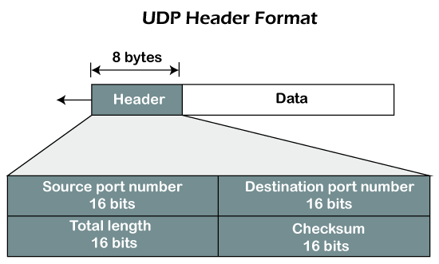
UDP Header
Source port number: It is 16-bit information that identifies which port is going t send the packet.
Destination port number: It identifies which port is going to accept the information. It is 16-bit information which is used to identify application-level service on the destination machine.
Length: It is 16-bit field that specifies the entire length of the UDP packet that includes the header also. The minimum value would be 8-byte as the size of the header is 8 bytes.
Checksum: It is a 16-bits field, and it is an optional field. This checksum field checks whether the information is accurate or not as there is the possibility that the information can be corrupted while transmission. It is an optional field, which means that it depends upon the application, whether it wants to write the checksum or not. If it does not want to write the checksum, then all the 16 bits are zero; otherwise, it writes the checksum. In UDP, the checksum field is applied to the entire packet, i.e., header as well as data part whereas, in IP, the checksum field is applied to only the header field.
Data: It is the encapsulated higher layer message to be sent. It is of variable size.

Slide 6
Q.1. Consider the UDP header 12 03 00 0F 00 1E A3 10. What is the total length of UDP?
Solution:
It is given 12 03 00 1E A3 10 is an UDP header.
Here, 12 03 represents source port, 00 0F represents destination port, 00 1E represents length and A3 10 represents checksum.
So, length 00 1E is 30 in decimal.

Slide 7
Q2. The following is a dump of a UDP header in hexadecimal form:
06 32 00 0D 00 1C E2 17
What is the
Source port number
Destination port number
Total length of the UDP
Length of the data
Considering that an IP frame can have a maximum total length of 65535 bytes, what is the maximum length of the data in a UDP frame?
Solution: The UDP header has four parts, each of two bytes. That means we get the following interpretation of the header.
Source port number = (0632)₁₆ = 1586
Destination port number = (000D)₁₆ = 13
Total length = (001C)₁₆ = 28 bytes
Since the header is 8 bytes the data length is 28 − 8 = 20 bytes.
The IP header is minimum 20 bytes, which gives the maximum payload 65515 bytes. To fit a UDP frame in this with header of 8 bytes we get data = 65515−8 = 65507 bytes.

Slide 8
TCP
TCP stands for Transmission Control Protocol.
It is a transport layer protocol that facilitates the transmission of packets from source to destination.
It is a connection-oriented protocol that means it establishes the connection prior to the communication that occurs between the computing devices in a network.
This protocol is used with an IP protocol, so together, they are referred to as a TCP/IP.
The main functionality of the TCP is to take the data from the application layer. Then it divides the data into a several packets, provides numbering to these packets, and finally transmits these packets to the destination.
The TCP, on the other side, will reassemble the packets and transmits them to the application layer.
As we know that TCP is a connection-oriented protocol, so the connection will remain established until the communication is not completed between the sender and the receiver.

Slide 9
Example 1
Imagine a TCP connection is transferring a file of 6000 bytes. The first byte is numbered 10010. What are the sequence numbers for each segment if data are sent in five segments with the first four segments carrying 1000 bytes and the last segment carrying 2000 bytes?
Solution
The following shows the sequence number for each segment:
Segment 1 ==> sequence number: 10,010 (range: 10,010 to 11,009)
Segment 2 ==> sequence number: 11,010 (range: 11,010 to 12,009)
Segment 3 ==> sequence number: 12,010 (range: 12,010 to 13,009)
Segment 4 ==> sequence number: 13,010 (range: 13,010 to 14,009)
Segment 5 ==> sequence number: 14,010 (range: 14,010 to 16,009)

Slide 10
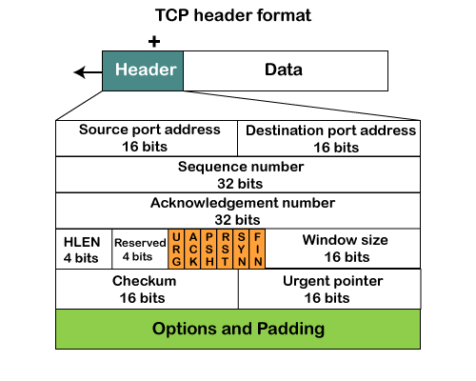
TCP Header Format
Source port: It defines the port of the application, which is sending the data. So, this field contains the source port address, which is 16 bits.
Destination port: It defines the port of the application on the receiving side. So, this field contains the destination port address, which is 16 bits.
Sequence number: This field contains the sequence number of data bytes in a particular session.
Acknowledgment number: When the ACK flag is set, then this contains the next sequence number of the data byte and works as an acknowledgment for the previous data received. For example, if the receiver receives the segment number 'x', then it responds 'x+1' as an acknowledgment number.
HLEN: It specifies the length of the header indicated by the 4-byte words in the header. The size of the header lies between 20 and 60 bytes. Therefore, the value of this field would lie between 5 and 15.
Reserved: It is a 4-bit field reserved for future use, and by default, all are set to zero.
Flags There are six control bits or flags:
URG: It represents an urgent pointer. If it is set, then the data is processed urgently.
ACK: If the ACK is set to 0, then it means that the data packet does not contain an acknowledgment.
PSH: If this field is set, then it requests the receiving device to push the data to the receiving application without buffering it.
RST: If it is set, then it requests to restart a connection.
SYN: It is used to establish a connection between the hosts.
FIN: It is used to release a connection, and no further data exchange will happen.
Window size It is a 16-bit field. It contains the size of data that the receiver can accept. This field is used for the flow control between the sender and receiver and also determines the amount of buffer allocated by the receiver for a segment. The value of this field is determined by the receiver.
Checksum It is a 16-bit field. This field is optional in UDP, but in the case of TCP/IP, this field is mandatory.
Urgent pointer It is a pointer that points to the urgent data byte if the URG flag is set to 1. It defines a value that will be added to the sequence number to get the sequence number of the last urgent byte.
Options It provides additional options. The optional field is represented in 32-bits. If this field contains the data less than 32-bit, then padding is required to obtain the remaining bits.

Slide 11
Q. The following is a dump of a TCP header in hexadecimal format.
05320017 00000001 00000000 500207FF 00000000
(a)What is the source port number? (b) What is the destination port number? (c)What is the sequence number?
(d) What is the acknowledgment number? (e) What is the length of header? (f) What is the type of segment?
(g) What is the window size?
Solution: TCP header itself is of 10 fields as below and size may vary between 20 to 60bytes
1. Source port - 2 bytes 2. destination port - 2 bytes 3. SEQ NUM-4 bytes 4. ACK NUM- 4 bytes 5.HLEN-1 word
6. RESERVED-6bits 7. CONTROL-6bits 8. WINDOW SIZE-2 bytes 9. CHECKSUM-2 bytes
10. URGENT POINTERS-2bytes
TCP header (in hex)=05320017 00000001 000000000 500207FF 00000000
since, each hex = 4 bits, we need to first split the above hex as such
05 32 00 17 00 00 00 01 00 00 00 00 50 02 07 FF 00 00 00 00
(a) source port is 2 bytes take 05 32 = 1330
(b) Next 2 bytes as destination address 00 17 = 23 (default TCP port)
(c) Next 4 bytes as sequence number 00 00 00 01 =1
(d) Next 4 bytes as ACK 00 00 00 00 = 0
(e) Next 4 bits as HLEN 5 =5; this indicates number of sets of 4 bytes which makes the header length = 20bytes.
(f) Next 6 bits are reserved i.e.0 =0000and 2 bits from hex 0
(g) Next 6 bits are control bits = remaining 2 bits from hex 0 and 4 bits of 2
(h) Next 2 bytes indicate the window length 07 FF = 2047 bytes
(i) Checksum 2 bytes 00 00 = 0
(j) Urgent pointer 2bytes 00 00 =0

Slide 12
TCP Vs UDP
Transmission Control Protocol (TCP) | User Datagram Protocol (UDP)
1. TCP is a connection-oriented protocol. Connection-orientation means that the communicating devices should establish a connection before transmitting data and should close the connection after transmitting the data. | 1. UDP is the Datagram oriented protocol. This is because there is no overhead for opening a connection, maintaining a connection, and terminating a connection. UDP is efficient for broadcast and multicast type of network transmission.
2. TCP is reliable as it guarantees delivery of data to the destination router. | 2. The delivery of data to the destination cannot be guaranteed in UDP.
3. TCP provides extensive error checking mechanisms. It is because it provides flow control and acknowledgment of data. | 3. UDP has only the basic error checking mechanism using checksums.
4. Sequencing of data is a feature of Transmission Control Protocol (TCP). this means that packets arrive in-order at the receiver. | 4. There is no sequencing of data in UDP. If ordering is required, it has to be managed by the application layer.
5. TCP is comparatively slower than UDP. | 5. UDP is faster, simpler and more efficient than TCP.
6. Retransmission of lost packets is possible in TCP, but not in UDP. | 6. There is no retransmission of lost packets in User Datagram Protocol (UDP).
7. TCP has a (20-80) bytes variable length header. | 7. UDP has a 8 bytes fixed length header.
8. TCP is heavy-weight. | 8. UDP is lightweight.
9. TCP doesn’t supports Broadcasting. | 9. UDP supports Broadcasting.
10. TCP is used by HTTP, HTTPs, FTP, SMTP and Telnet. | 10. UDP is used by DNS, DHCP, TFTP, SNMP, RIP, and VoIP.

Slide 13
TCP Timers
TCP (Transmission Control Protocol) uses various timers to manage the flow of data between two endpoints. These timers play a crucial role in ensuring reliable and efficient data transmission over a network. Here are some of the important TCP timers:
Retransmission timer: When a sender transmits a segment, it starts a retransmission timer for that segment. If an acknowledgment for that segment is not received before the timer expires, the sender retransmits the segment.
Keepalive timer: This timer is used to check if a connection is still active. If a connection is idle for a certain period of time, the sender sends a keepalive packet to the receiver. If the receiver does not respond to the keepalive packet, the sender assumes that the connection has been lost and terminates the connection.
Time-wait timer: When a TCP connection is closed, the endpoint that initiated the close enters the time-wait state. During this state, the endpoint waits for a certain amount of time before terminating the connection. This timer is used to ensure that any delayed packets related to the connection have been processed before the connection is closed.
Congestion control timer: This timer is used to manage congestion on a network. When congestion is detected, the sender reduces the sending rate and starts a congestion control timer. When the timer expires, the sender gradually increases the sending rate.

Slide 14
Transport Service Primitives
A service is specified by a set of primitives. A primitive means operation. To access the service a user process can access these primitives. These primitives are different for connection oriented service and connectionless service.
There are five types of service primitives:
LISTEN : When a server is ready to accept an incoming connection it executes the LISTEN primitive. It blocks waiting for an incoming connection.
CONNECT : It connects the server by establishing a connection. Response is awaited.
RECEIVE: Then the RECEIVE call blocks the server.
SEND : Then the client executes SEND primitive to transmit its request followed by the execution of RECIEVE to get the reply. Send the message.
DISCONNECT : This primitive is used for terminating the connection. After this primitive one can’t send any message. When the client sends DISCONNECT packet then the server also sends the DISCONNECT packet to acknowledge the client. When the server package is received by client then the process is terminated.

Slide 15
BERKLEY SOCKETS
Socket:
1. Sockets are a service provided by transport layer.
2. A socket is one endpoint of a two-way communication link between two programs running on the network.
Berkeley Socket:
A Berkeley socket is an application programming interface (API) for Internet sockets and UNIX domain sockets.
It is used for inter-process communication (IPC).
It is commonly implemented as a library of linkable modules.
It originated with the 4.2BSD UNIX released in 1983.
The term POSIX sockets are essentially synonymous with Berkeley sockets, but they are also known as BSD sockets.

Slide 16
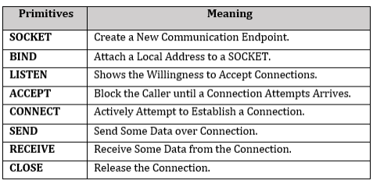
Primitives used in Socket Programming

Slide 17
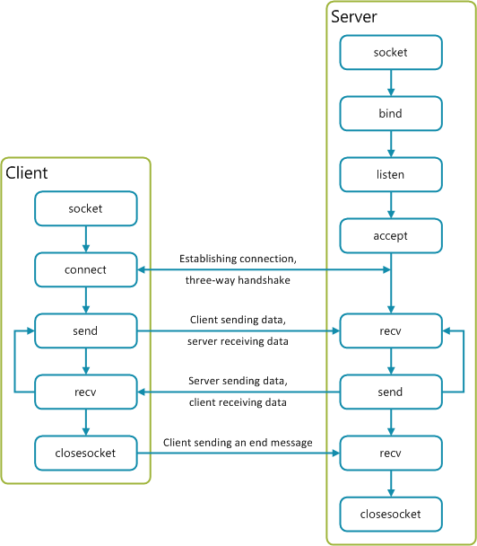
Socket Programming
Server side:
Server startup executes SOCKET, BIND & LISTEN primitives.
LISTEN primitive allocate queue for multiple simultaneous clients.
Then it use ACCEPT to suspend server until request.
When client request arrives: ACCEPT returns.
Start new socket (thread or process) with same properties as original, this handles the request, server goes on waiting on original socket.
If new request arrives while spawning thread for this one, it is queued.
If queue full it is refused.
Client side:
It uses SOCKET primitives to create.
Then use CONNECT to initiate connection process.
When this returns the socket is open.
Both sides can now SEND, RECEIVE.
Connection not released until both sides do CLOSE.
Typically client does it, server acknowledges.

Slide 18
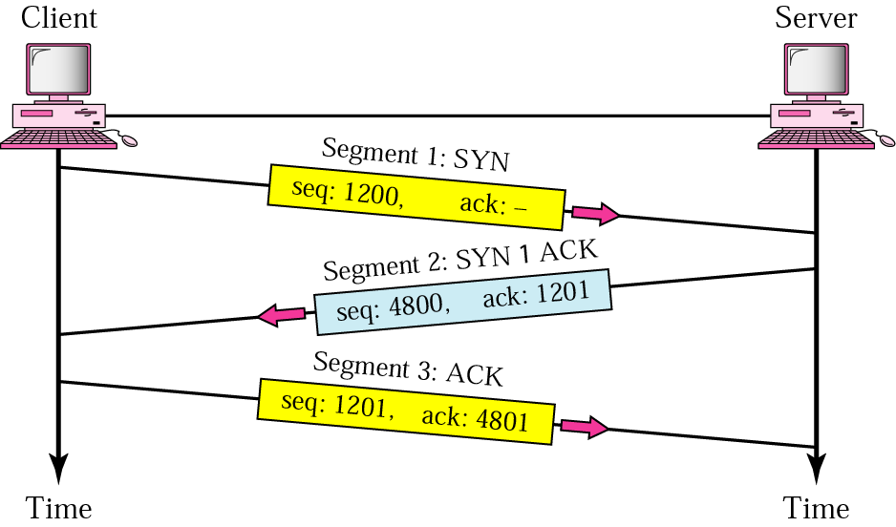
Connection Management (Three-step connection establishment) using Handshake Process
Step 1 (SYN): In the first step, the client wants to establish a connection with a server, so it sends a segment with SYN(Synchronize Sequence Number) which informs the server that the client is likely to start communication and with what sequence number it starts segments with.
Step 2 (SYN + ACK): Server responds to the client request with SYN-ACK signal bits set. Acknowledgement(ACK) signifies the response of the segment it received and SYN signifies with what sequence number it is likely to start the segments with.
Step 3 (ACK): In the final part client acknowledges the response of the server and they both establish a reliable connection with which they will start the actual data transfer.

Slide 19
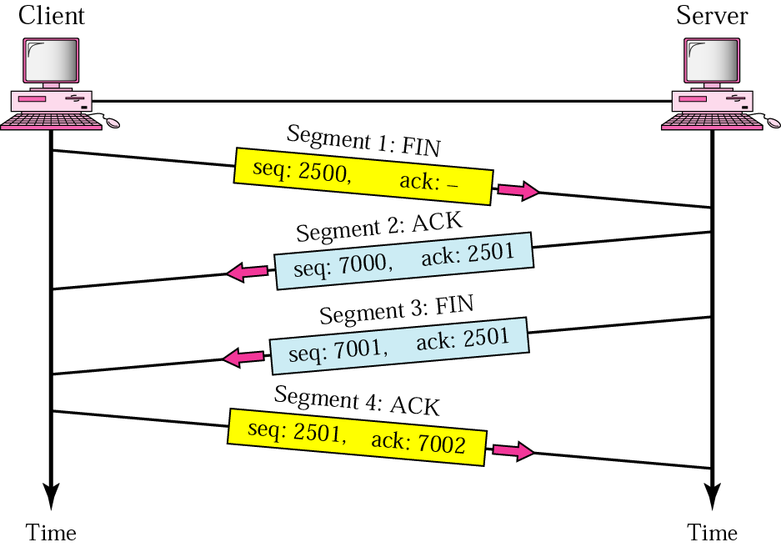
Four-step connection termination/ Connection Release
TCP connections are full duplex.
Each simplex connection is released independently of its sibling.
To release a connection, either party can send a TCP segment with the FIN bit set, which means that it has no more data to transmit.
When the FIN is acknowledged, that direction is shut down for new data.
Data may continue to flow indefinitely in the other direction, however.
When both directions have been shut down, the connection is released.
Normally, four TCP segments are needed to release a connection, one FIN and one ACK for each direction.
However, it is possible for the first ACK and the second FIN to be contained in the same segment, reducing the total count to three.

Slide 20
States for TCP
State | Description
CLOSED | There is no connection.
LISTEN | The server is waiting for calls from the client.
SYN-SENT | A connection request is sent; waiting for acknowledgment.
SYN-RCVD | A connection request is received.
ESTABLISHED | Connection is established.
FIN-WAIT-1 | The application has requested the closing of the connection.
FIN-WAIT-2 | The other side has accepted the closing of the connection.
TIME-WAIT | Waiting for retransmitted segments to die.
CLOSE-WAIT | The server is waiting for the application to close.
LAST-ACK | The server is waiting for the last acknowledgment.

Slide 21
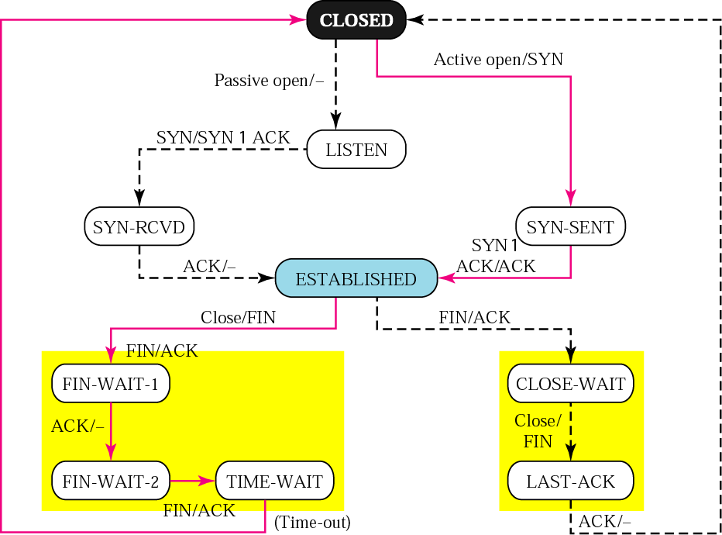
State transition diagram
A TCP connection goes through a series of states during its lifetime.
Figure below shows the state transition diagram.
Each state transition is indicated by an arrow, and the associated label indicates associated events and actions.
Connection establishment begins in the CLOSED state and proceeds to the ESTABLISHED state.
Connection termination goes from the ESTABLISHED state to the CLOSED state.
The normal transitions for a client are indicated by thick solid lines, and the normal transitions for a server are denoted by dashed lines.
Thus when a client does an active open, it goes from the CLOSED state, to SYN_SENT, and then to ESTABLISHED.
The server carrying out a passive open goes from the CLOSED state, to LISTEN, SYN_RCVD, and then to ESTABLISHED.
The client normally initiates the termination of the connection by sending a FIN.
The associated state trajectory goes from the ESTABLISHED state, to FIN_WAIT_1 while it waits for an ACK, to FIN_WAIT_2while it waits for the other side's FIN, and then to TIME WAIT after it sends the final ACK.
When the TIME_WAIT 2MSL period expires, the connection is closed.

